Slide 1
LESSON 26

Slide 2
Overview
of
Previous Lesson(s)

Slide 3
Over View
An ambiguous grammar which fails to be LR and thus is not in any of the classes of grammars i.e SLR, LALR
Certain ambiguous grammars are quite useful in the specification and implementation of languages.
For language constructs like expressions, an ambiguous grammar provides a shorter, more natural specification than any equivalent unambiguous grammar.
Another use of ambiguous grammars is in isolating commonly occurring syntactic constructs for special-case optimization.

Slide 4
Over View..
Ambiguous grammar for expressions with operators + and * :
E → E + T | E * T | (E) | id
This grammar is ambiguous because it does not specify the associativity or precedence of the operators + and *
The unambiguous grammar, generates the same language, but gives + lower precedence than * and makes both operators left associative.
E → E + T
T → T * F

Slide 5
Over View…
02 reasons we prefer to use the ambiguous grammar.
First, we can easily change the associativity and precedence of the operators + and * without disturbing the productions or the number of states in the resulting parser.
Second, the parser for the unambiguous grammar will spend a substantial fraction of its time reducing by the productions
E → E + T & T → T * F
whose sole function is to enforce associativity and precedence.

Slide 6
Over View…
An LR parser will detect an error when it consults the parsing action table and finds an error entry.
A canonical LR parser will not make even a single reduction before announcing an error.
SLR and LALR parsers may make several reductions before announcing an error, but they will never shift an erroneous input symbol onto the stack.
In LR parsing, panic-mode error recovery and Phrase-level recovery can be implemented.

Slide 7
Over View…
In syntax-directed translation we construct a parse tree or a syntax tree, and then to compute the values of attributes at the nodes of the tree by visiting the nodes of the tree.
Syntax-directed translations called L-attributed translations which encompass virtually all translations that can be performed during parsing.
S-attributed translations can be performed in connection with a bottom-up parse.
A syntax-directed definition (SDD) is a context-free grammar together with attributes and rules.

Slide 8
Over View…
A synthesized attribute for a non-terminal A at a parse-tree node N is defined by a semantic rule associated with the production at N.
The production must have A as its head.
A synthesized attribute at node N is defined only in terms of attribute values at the children of N and at N itself.
A parse tree for an S-attributed definition can always be annotated by evaluating the semantic rules for the attributes at each node bottom up, from the leaves to the root.

Slide 9
Over View…
An inherited attribute for a non-terminal B at a parse-tree node N is defined by a semantic rule associated with the production at the parent of N.
The production must have B as a symbol in its body.
An inherited attribute at node N is defined only in terms of attribute values at N's parent , N itself, and N's siblings.
Inherited attributes are convenient for expressing the dependence of a programming language construct on the context in which it appears.

Slide 10
TODAY’S LESSON

Slide 11
Contents
Syntax-Directed Definitions
Inherited and Synthesized Attributes
Evaluating an SDD at the Nodes of a Parse Tree
Evaluation Orders for SDD's
Dependency Graphs
Ordering the Evaluation of Attributes
S-Attributed Definitions
L-Attributed Definitions
Semantic Rules with Controlled Side Effects
Applications of Syntax-Directed Translation
Construction of Syntax Trees
The Structure of a Type

Slide 12
Evaluating an SDD at the Nodes of a Parse Tree..
Inherited attributes are useful when the structure of a parse tree does not "match" the abstract syntax of the source code.
Now we see an example which shows how inherited attributes can be used to overcome such a mismatch due to a grammar designed for parsing rather than translation.

Slide 13
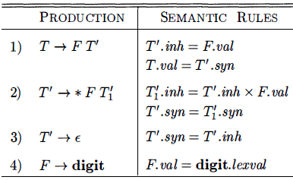
Evaluating an SDD at the Nodes of a Parse Tree...
It computes terms like 3 * 5 and 3 * 5 * 7.
The top-down parse of input 3 * 5 begins with the production T → FT’
F generates the digit 3, but the operator * is generated by T'.
Thus, the left operand 3 appears in a different sub tree of the parse tree from *
An inherited attribute will therefore be used to pass the operand to the operator.

Slide 14
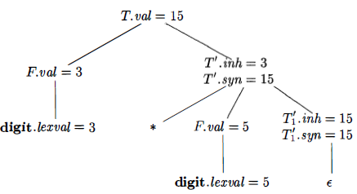
Evaluating an SDD at the Nodes of a Parse Tree...
Each of the non-terminals T and F has a synthesized attribute val; the terminal digit has a synthesized attribute lexval.
The non-terminal T' has two attributes:
An inherited attribute inh
A synthesized attribute syn
The semantic rules are based on the idea that the left operand of the operator * is inherited.

Slide 15
Dependency Graphs
A dependency graph depicts the flow of information among the attribute instances in a particular parse tree.
An edge from one attribute instance to another means that the value of the first is needed to compute the second.
Edges express constraints implied by the semantic rules.

Slide 16
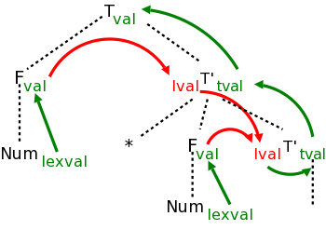
Dependency Graphs..
The black dotted lines comprise the parse tree for the multiplication grammar just studied when applied to a single multiplication, e.g. 3*5.
Each synthesized attribute is shown in green and is written to the right of the grammar symbol at the node where it is defined.
Each inherited attribute is shown in red and is written to the left of the grammar symbol where it is defined.

Slide 17
Dependency Graphs..
Each green arrow points to the synthesized attribute calculated from the attribute at the tail of the arrow.
These arrows either go up the tree one level or stay at a node.
That is because a synthesized attribute can depend only on the node where it is defined and that node's children.
The computation of the attribute is associated with the production at the node at its arrowhead.

Slide 18
Dependency Graphs..
Each red arrow points to the inherited attribute calculated from the attribute at the tail.
Note that two red arrows point to the same attribute.
This indicates that the common attribute at the arrowheads, depends on both attributes at the tails.
According to the rules for inherited attributes, these arrows either go down the tree one level, go from a node to a sibling, or stay within a node.
The computation of the attribute is associated with the production at the parent of the node at the arrowhead.

Slide 19
Ordering the Evaluation of Attributes
The dependency graph characterizes the possible orders in which we can evaluate the attributes at the various nodes of a parse tree.
If the dependency graph has an edge from node M to node N then the attribute corresponding to M must be evaluated before the attribute of N.
The only allowable orders of evaluation are those sequences of nodes N₁, N₂, … ,N_{k} such that if there is an edge of the dependency graph from N_{i} to N_{j} then i < j
Such an ordering embeds a directed graph into a linear order, and is called a topological sort of the graph.

Slide 20
Ordering the Evaluation of Attributes..
The rule is that the needed ordering can be found if and only if there are no (directed) cycles.
The algorithm is simple.
Choose a node having no incoming edges
Delete the node and all incident edges.
Repeat

Slide 21
Ordering the Evaluation of Attributes…
If the algorithm terminates with nodes remaining, there is a directed cycle within these remaining nodes and hence no suitable evaluation order.
If the algorithm succeeds in deleting all the nodes, then the deletion order is a suitable evaluation order and there were no directed cycles.
The topological sort algorithm is nondeterministic (Choose a node) and hence there can be many topological sort orders.

Slide 22
S-Attributed Definitions
Given an SDD and a parse tree, it is easy to tell (by doing a topological sort) whether a suitable evaluation exists or not.
A difficult problem is, given an SDD, are there any parse trees with cycles in their dependency graphs, i.e., are there suitable evaluation orders for all parse trees.
There are classes of SDDs for which a suitable evaluation order is guaranteed. The first class is defined as follows:
An SDD is S-attributed if every attribute is synthesized.

Slide 23
S-Attributed Definitions..
For these SDDs all attributes are calculated from attribute values at the children since the other possibility, the tail attribute is at the same node, is impossible since the tail attribute must be inherited for such arrows.
Thus no cycles are possible and the attributes can be evaluated by a post-order traversal of the parse tree.
Since post-order corresponds to the actions of an LR parser when reducing the body of a production to its head, it is often convenient to evaluate synthesized attributes during an LR parse.

Slide 24
L-Attributed Definitions
The second class of SDD's is called L-attributed definitions
The idea behind this class is that dependency-graph edges can go from left to right but not from right to left between the attributes associated with a production body.
Each attribute must be either
Synthesized OR Inherited
But with limited rules.

Slide 25
L-Attributed Definitions..
Suppose that there is a production A → X₁, X₂, … , X_{n} and that there is an inherited attribute X_{1.a} computed by a rule associated with this production. Then the rule may use only:
Inherited attributes associated with the head A.
Either inherited or synthesized attributes associated with the occurrences of symbols X₁, X₂, … , X_{i-1} located to the left of X_{i}
Inherited or synthesized attributes associated with this occurrence of X_{i} itself, but only in such a way that there are no cycles in a dependency graph formed by the attributes of this X_{i}

Slide 26
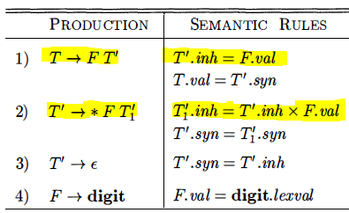
L-Attributed Definitions...
This SDD is L-attributed
The first of these rules defines the inherited attribute T'.inh using only F. val, and F appears to the left of T' in the production body.
The second rule defines T₁‘.inh using the inherited attribute T'.inh associated with the head, and F. val, where F appears to the left of T₁‘ in the production body.

Slide 27
Semantic Rules with Controlled Side Effects
Translation schemes involve side effects:
A desk calculator might print a result
A code generator might enter the type of an identifier into a symbol table
With SDD's, we strike a balance between attribute grammars and translation schemes.
Attribute grammars have no side effects and allow any evaluation order consistent with the dependency graph.
Translation schemes impose left-to-right evaluation and allow semantic actions to contain any program fragment.

Slide 28
Semantic Rules with Controlled Side Effects..
Side effects in SDD's can be controlled by one of the following ways:
Permit incidental side effects that do not constrain attribute evaluation. In other words, permit side effects when attribute evaluation based on any topological sort of the dependency graph produces a "correct" translation, where "correct" depends on the application.
Constrain the allowable evaluation orders, so that the same translation is produced for any allowable order. The constraints can be thought of as implicit edges added to the dependency graph.

Slide 29
Applications of SD Translation
Application includes the construction of syntax trees.
Some compilers use syntax trees as an intermediate representation, a common form of SDD turns its input string into a tree.
To complete the translation to intermediate code, the compiler may then walk the syntax tree, using another set of rules that are in effect an SDD on the syntax tree rather than the parse tree.

Slide 30
Construction of Syntax Trees
Each node in a syntax tree represents a construct.
Children of the node represent the meaningful components of the construct.
A syntax-tree node representing an expression E₁ + E₂ has label + and two children representing the sub expressions E₁ and E₂
We shall implement the nodes of a syntax tree by objects with a suitable number of fields.
Each object will have an op field that is the label of the node.

Slide 31
Construction of Syntax Trees..
The objects will have additional fields as follows:
If the node is a leaf, an additional field holds the lexical value for the leaf.
A constructor function Leaf( op, val) creates a leaf object.
Alternatively, if nodes are viewed as records, then Leaf returns a pointer to a new record for a leaf.
If the node is an interior node, there are as many additional fields as the node has children in the syntax tree.
A constructor function Node takes two or more arguments: Node (op, C₁ , C₂ , ... ,C_{k} ) creates an object with first field op and k additional fields for the k children C₁ , ... ,C_{k}

Slide 32
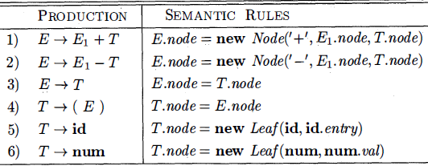
Construction of Syntax Trees…
This S-attributed definition constructs syntax trees for a simple expression grammar involving only the binary operators + and –
These operators are at the same precedence level & are jointly left associative.
All non-terminals have one synthesized attribute node, which represents a node of the syntax tree.
Every time the first production E → E₁ + T is used, its rule creates a node with ' + ' for op and two children, E₁ node and T node, for the sub-expressions.

Slide 33
Construction of Syntax Trees…
Same semantic action with other sign for 2nd production.
For production 3 & 4 no node is created.
The last two T-productions have a single terminal on the right.
We use the constructor Leaf to create a suitable node, which becomes the value of T. node
Now we will see the construction of a syntax tree for the input a - 4 + c

Slide 34
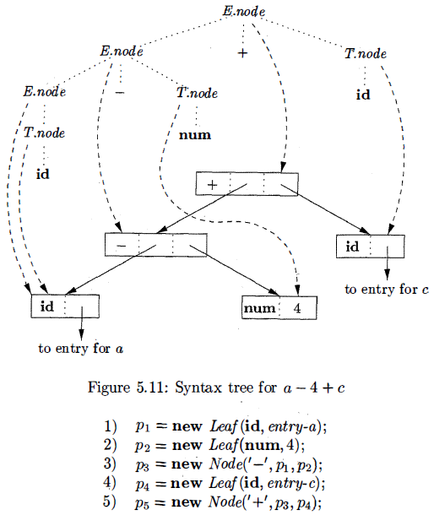
Construction of Syntax Trees…
Steps in the construction of the syntax tree for a - 4 + c

Slide 35
Thank You

